Slide 1




SSH
Cheat sheet
Guide

Slide 2

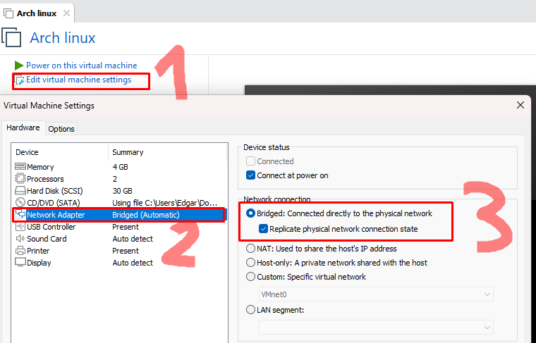
Pre requisites
Ubuntu used*

Slide 3
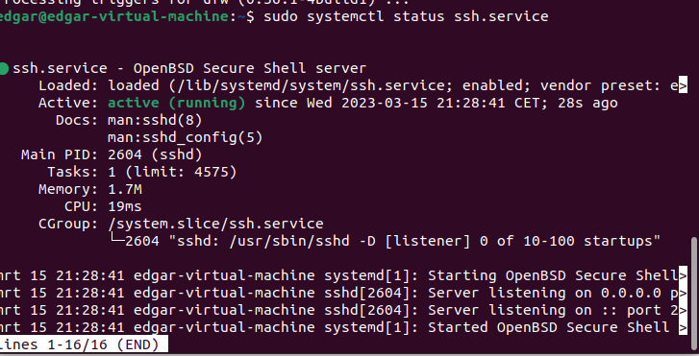
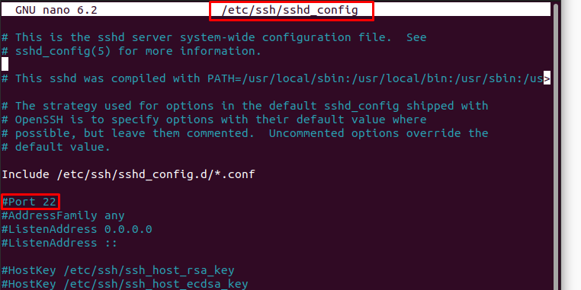
SSH server
Commands used in terminal:
sudo apt install openssh-server
sudo systemctl status ssh.service
sudo nano /etc/ssh/sshd_config

Slide 4
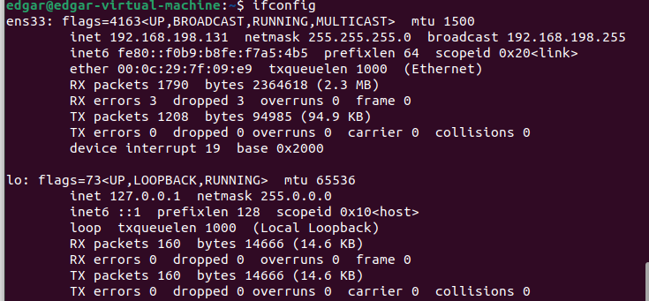
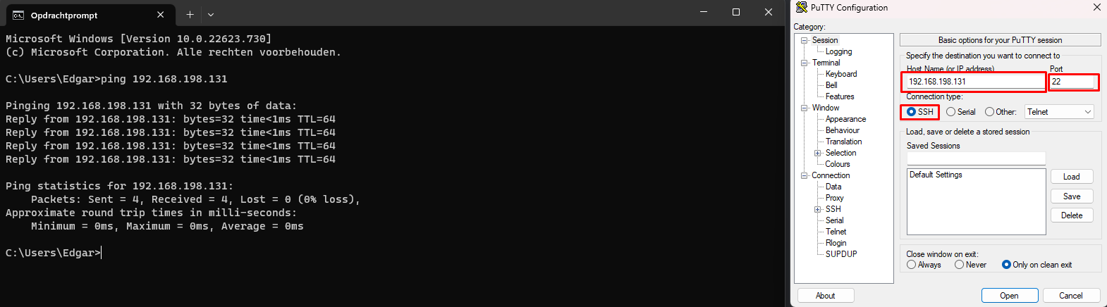
PuTTY ssh client
SSH
Download PuTTY Client: https://www.chiark.greenend.org.uk/~sgtatham/putty/latest.html
Check ip-address of linux machine (ifconfig in terminal)
Input correct settings to connect with SSH

Slide 5
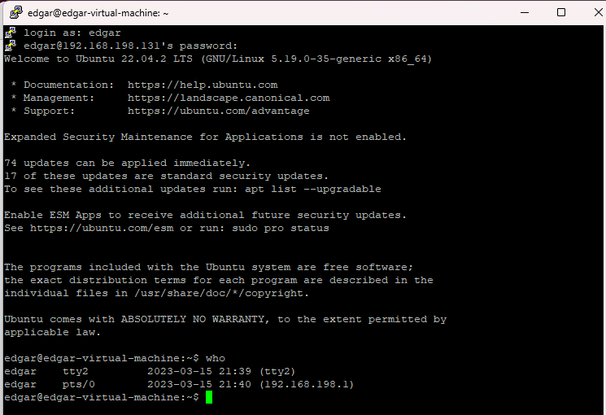

Slide 6
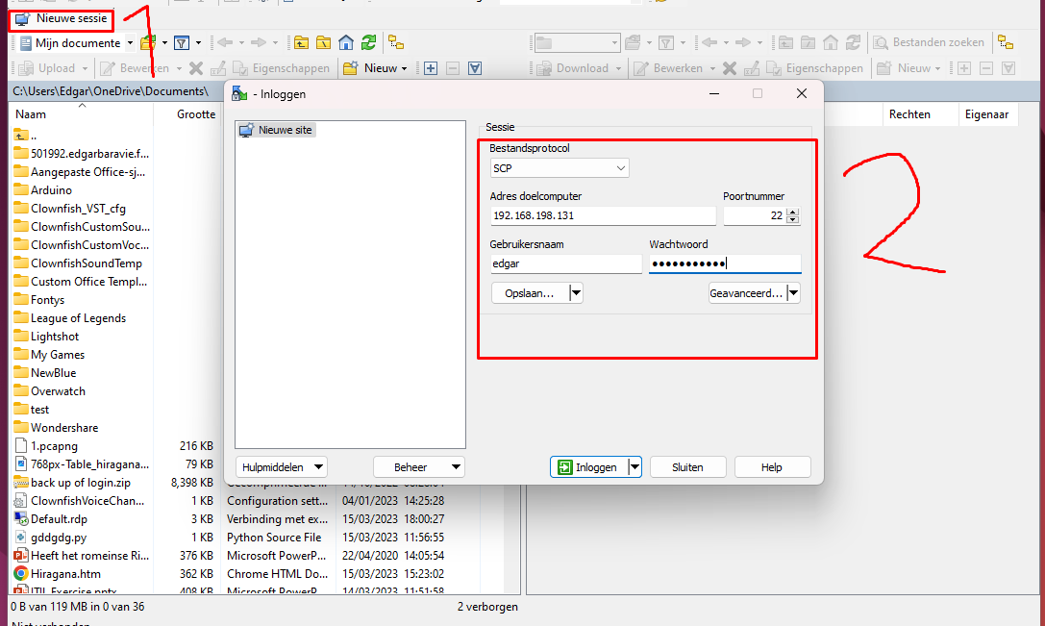
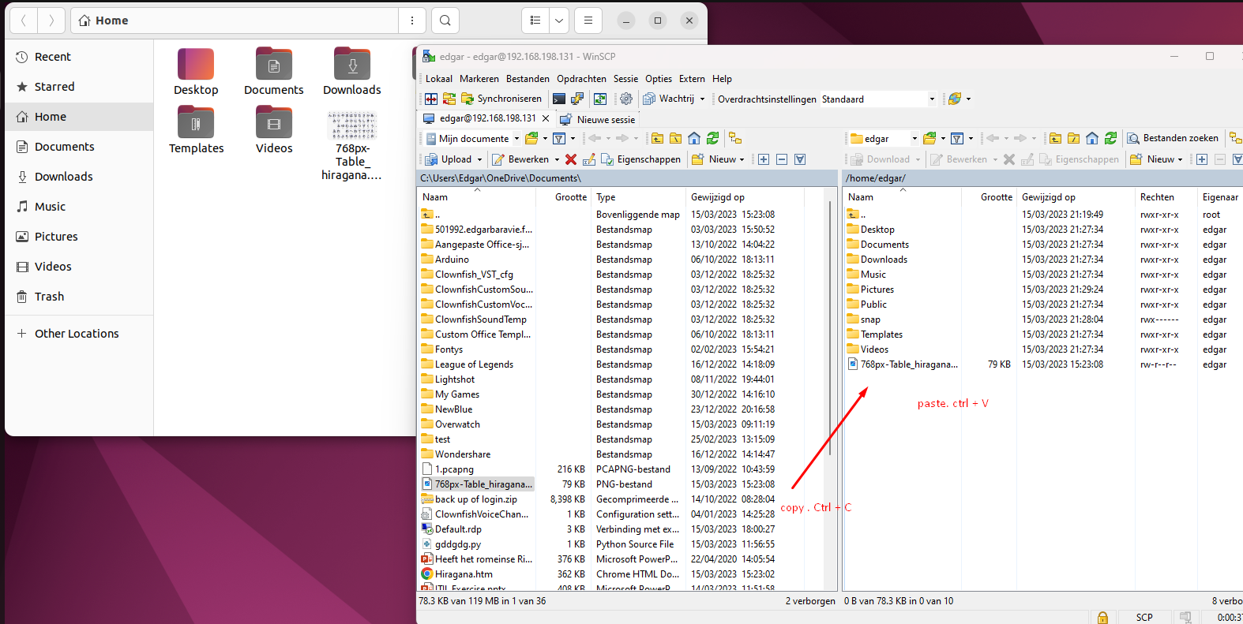
Copy files to linux machine
WinSCP: https://winscp.net/eng/download.php

Slide 7
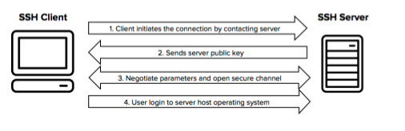
Wireshark
Why we use SSH, and not Telnet ?

Slide 8
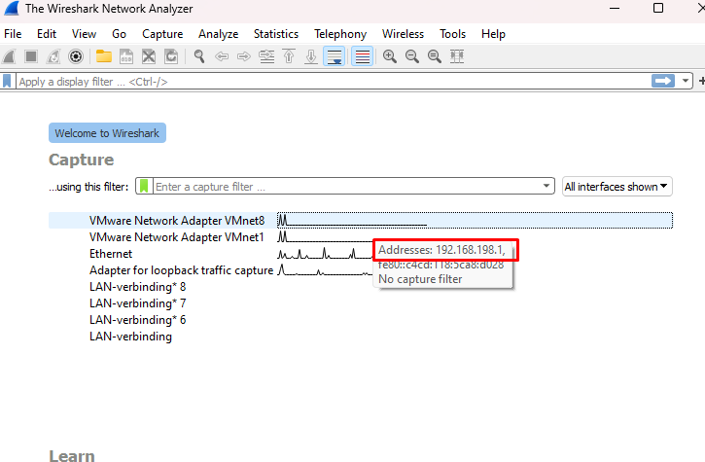
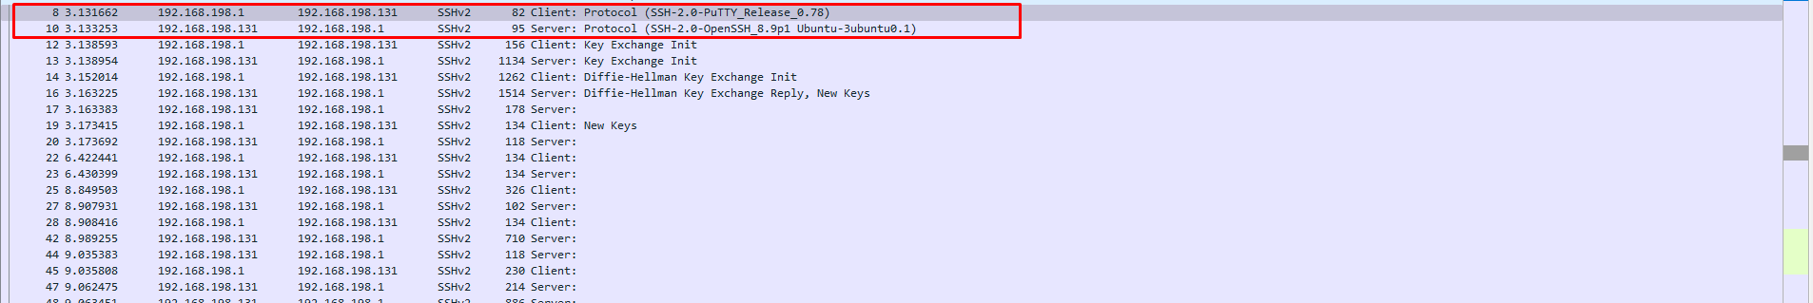
1. Client initiates the connection by contacting server

Slide 9
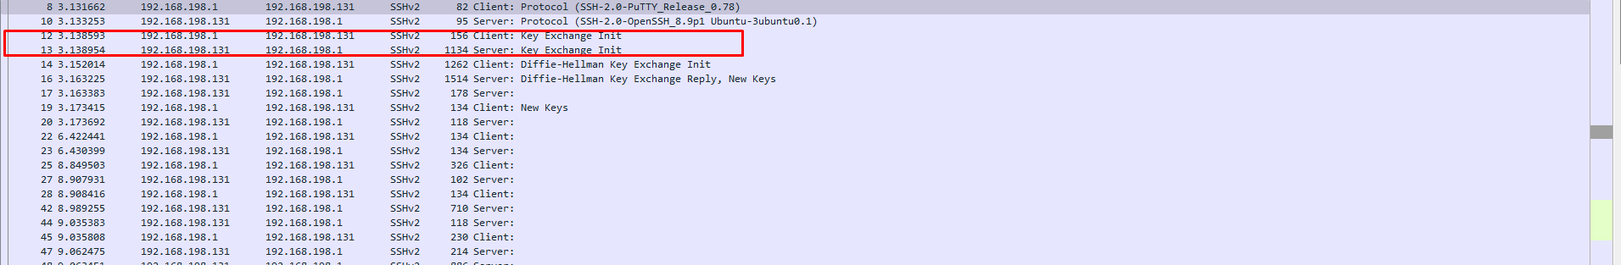
2. sends server public key

Slide 10
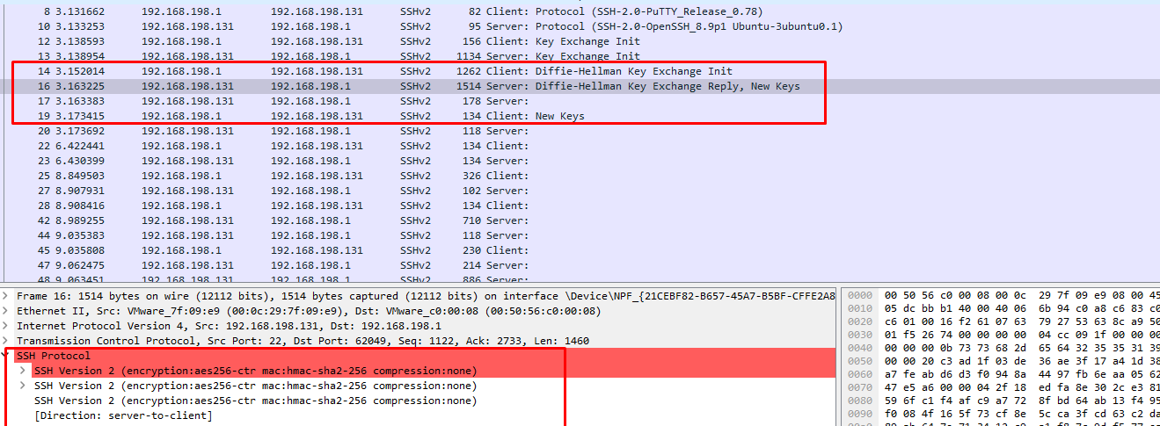
3. Negotiate parameters and open secure channel

Slide 11
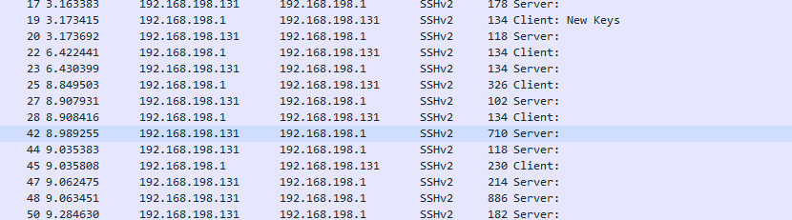
4. User login to server host operating system

Slide 12
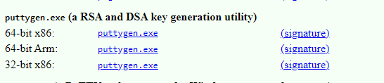
How to login with SSH without password
https://www.youtube.com/watch?v=4jakCV5JYx0
https://www.chiark.greenend.org.uk/~sgtatham/putty/latest.html

Slide 13
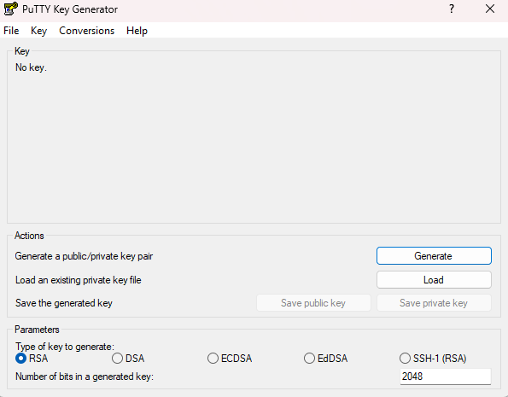
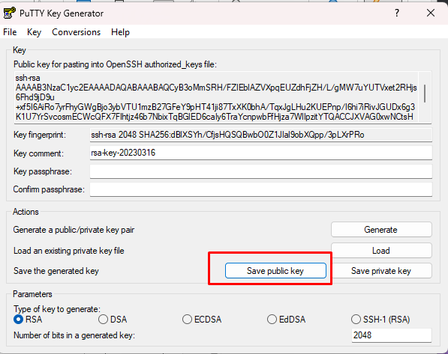
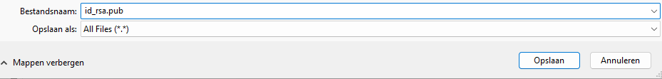

Slide 14
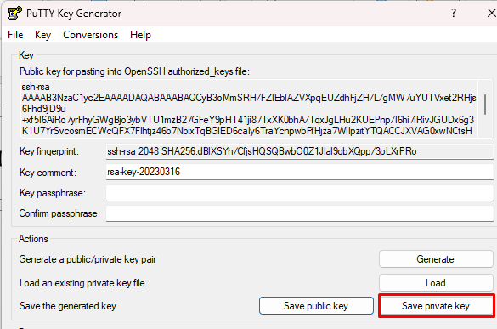
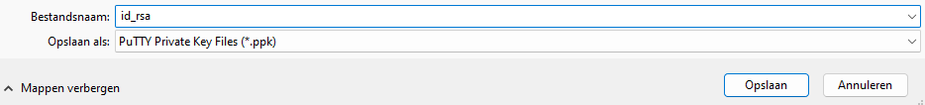
Save without password

Slide 15
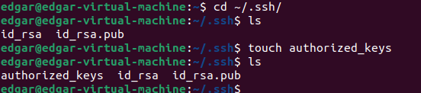
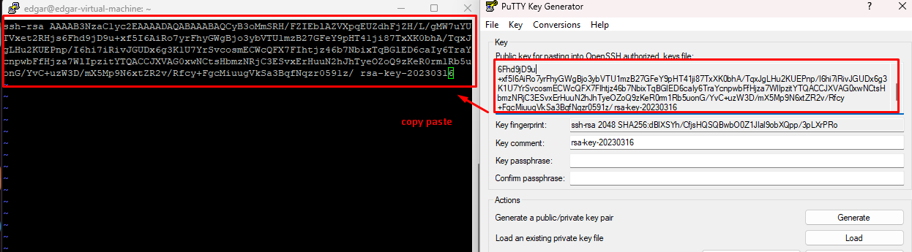

Slide 16
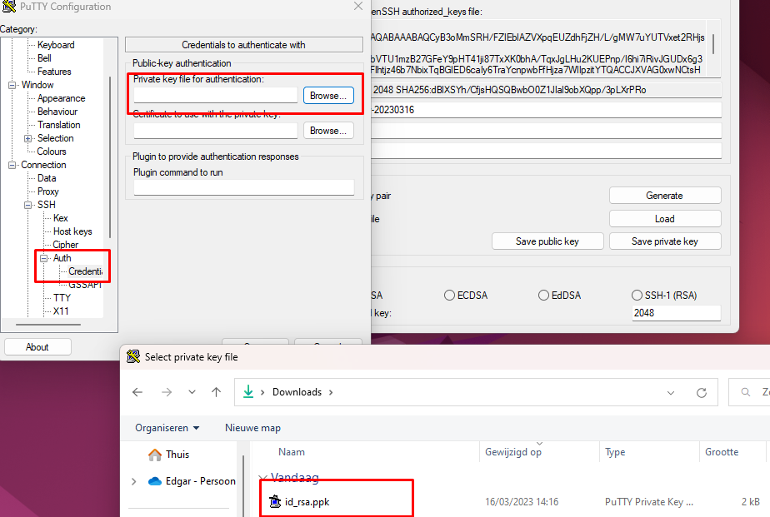
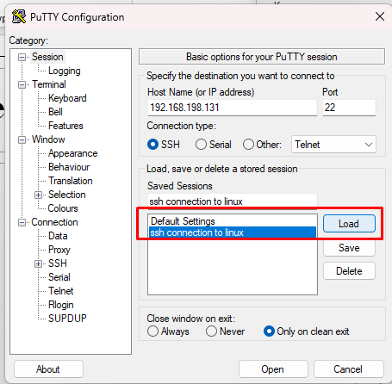

Slide 17
